Slide 1

Department of Health Informatics,
Rutgers the State University of New Jersey
BINF5115
SQL
Project
Riddhi Vyas
April 30,2024
Laboratory Database Management System (DBMS).
Payal vaidya

Slide 2

Background of DBMS.
The vast amounts of data produced by laboratory experiments and research are managed and maintained using a Laboratory Database Management System (DBMS).
For ease of access and analysis, it compiles test results, patient information, sample data, and test records into a single repository.
Through accurate sample tracking from receipt to testing and result distribution, the DBMS improves data accuracy and operational efficiency.
It allows for thorough reporting, real-time data retrieval, and compliance with regulatory criteria.
In clinical settings, the DBMS plays a critical role in managing resources, guaranteeing quality control, and assisting with prompt patient diagnosis and treatment.

Slide 3
Background of DBMS.
We can be sure that the database will suit our laboratory's changing needs because of its scalability and extension capabilities. As laboratory technologies and informatics continue to grow, the system will be well-positioned to keep up with these developments.
Our dedication to using technology to improve operational effectiveness, data integrity, and—above all—patient care results is demonstrated by the laboratory database system.
This signifies not only a financial commitment to technology but also to the ongoing enhancement of our laboratory's services and the overall health and welfare of our patients.

Slide 4

Introduction of database system
The laboratory database management system is carefully arranged into seven interconnected tables, each with a unique set of attributes that together create the system's data structure.
Doctors Table (1:M): Doctor Name, Specialty, Contact, Address, and Doctor ID (Primary Key) Its purpose is to keep track of every doctor's details, such as their specialization and contact information. As a master table.
Patients Table(1:M): Patient_ID (primary key), Foreign Key (doctor_ID), Name, Contact, Date of Birth (DOB), and Age Goal: Compiles all patient-related personal and medical information. To preserve the relationship between patients and their attending physicians, it links to the Doctor’s table using the Doctor_ID. The patient table is the child's table of doctor’s table.
Appointments Table(1:M): Appointment_ID (Primary Key), Foreign Keys for Patients and Doctors, Appointment_Date, and Appointment_Time Goal: Maintains a record of every appointment, including the time and date, and connects to the tables for patients and doctors using their respective IDs. The child table of the patient table

Slide 5

Introduction of database system
Test_Orders Table (1:M):Test_ID (Primary Key), Patient_ID (Foreign Key), Appt_ID (Foreign Key), Source, Order_Date, Description, and Cost are the attributes. Child table of Appointment table. Logs all patient tests requested, including what they include and how much they cost. The Appt_ID and Patient_ID columns link this table to the Appointments and Patients tables.
Test_Results Table Properties (1:M): Results, Result_Date; Patient_ID (Foreign Key); Test_ID (Foreign Key); Result_ID (Primary Key). Goal: Provide a complete set of results for every test by containing the outcomes of the tests carried out and connecting them to the Test_Orders database using the Test_ID. Child table of Test orders table.
Billing_Info Table (1:M): Bill_ID (Primary Key), Patient_ID (Foreign Key), Result_ID (Foreign Key), Bill_Date, Status, and Amount Goal: Handles test-related financial activities, recording the cost and payment status for each test performed and providing linkages to the Test_Results table via Result_ID. Child table of test results table.
Survey Table (1:M): Comments, Satisfaction, Bill_ID (Foreign Key), Survey_ID (Primary Key), Date of Survey Goal: By collecting patient input on their experience and the caliber of the services, it closes the loop on patient care and service quality evaluation. It is linked to the Billing_Info table through the Bill_ID. Child table of the Billing info table.

Slide 6
Information Flow The data flow of this laboratory patient database aims to demonstrate the following patient care journey:
Patient Registration: A patient's information is initially recorded in the Patient table.
Doctor Assignment: A relationship between the Patients and Doctors tables is created when a doctor is assigned to each patient.
Appointment Scheduling: A one-to-many established between patients and doctors when appointments are entered into the Appointments database.
Test Ordering and Results: When medical tests are performed and results are acquired, the Test_Orders table is filled first, then the Test_Results table is filled as well.
Billing: By connecting the test costs and outcomes, the Billing_Info table records the financial side of post-test conduct.

Slide 7
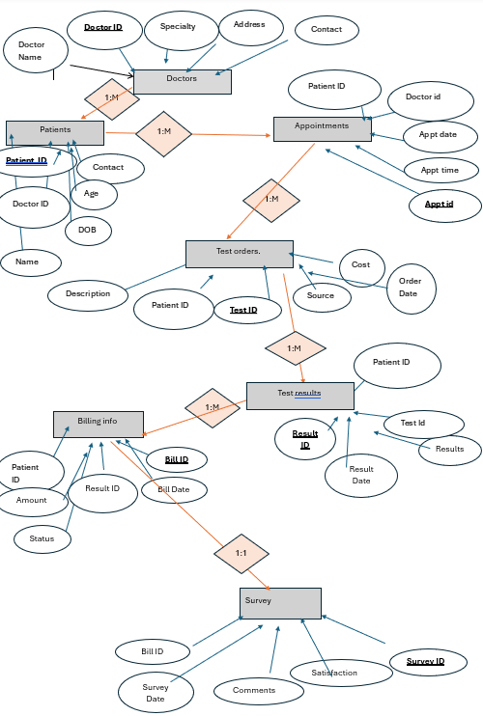

Slide 8
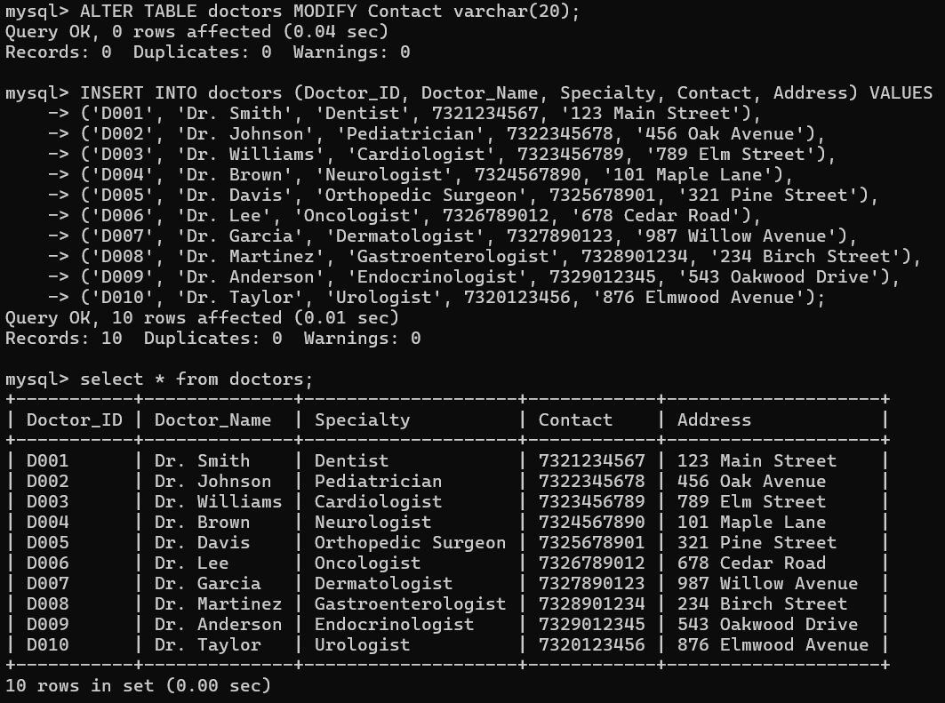

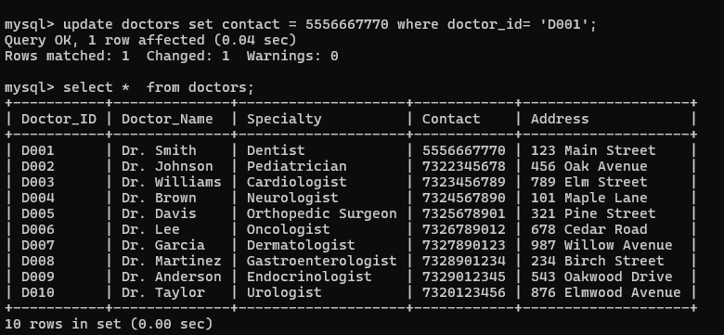
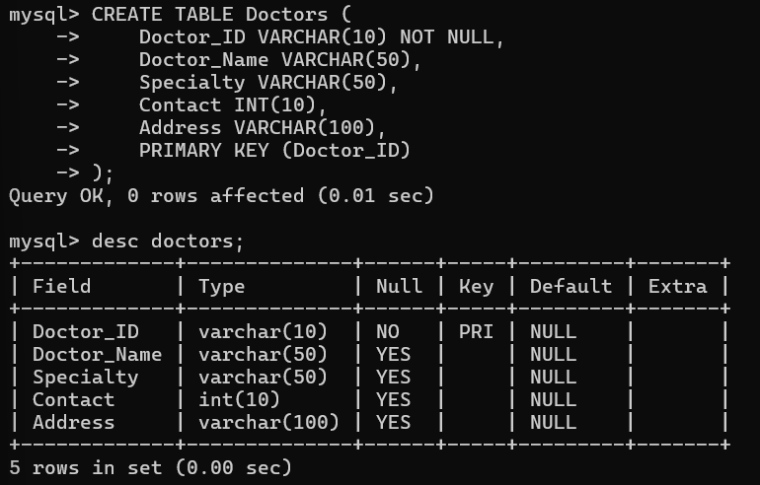
Methods: Doctor table (master table)

Slide 9
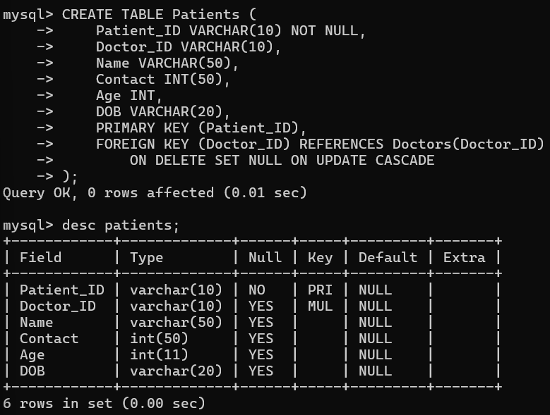
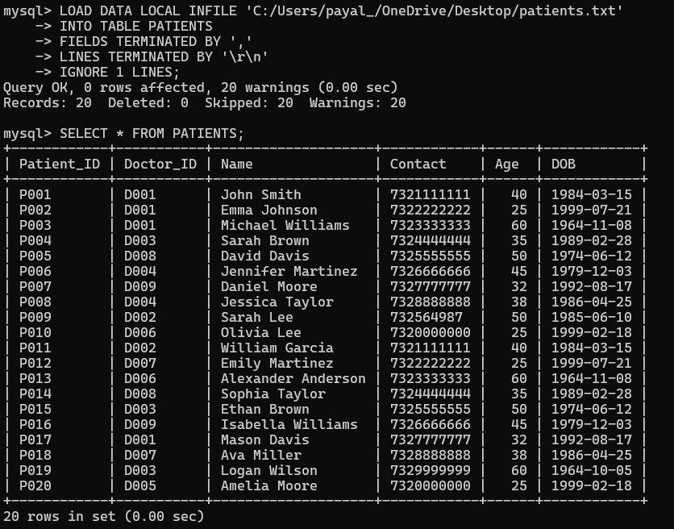
Patient table

Slide 10
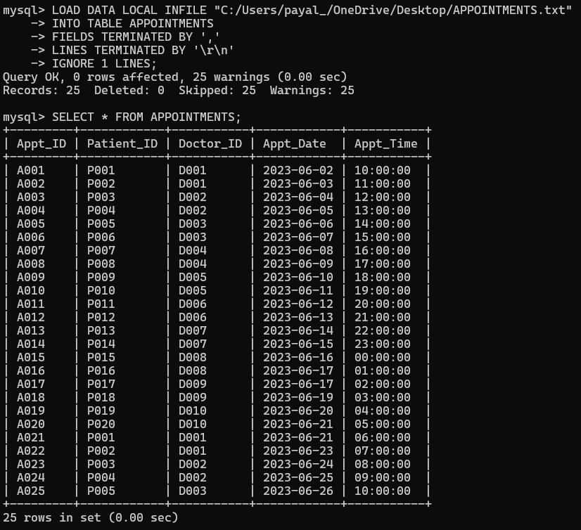
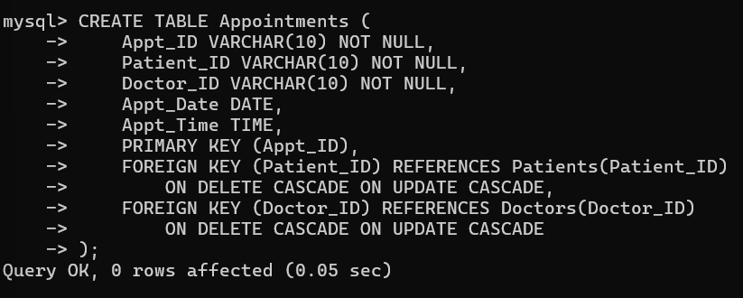
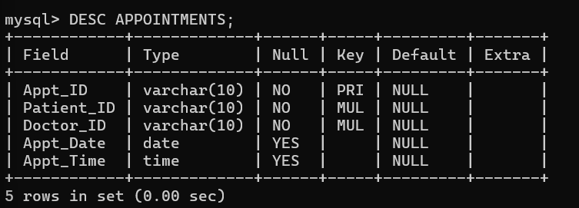
Appointment table

Slide 11
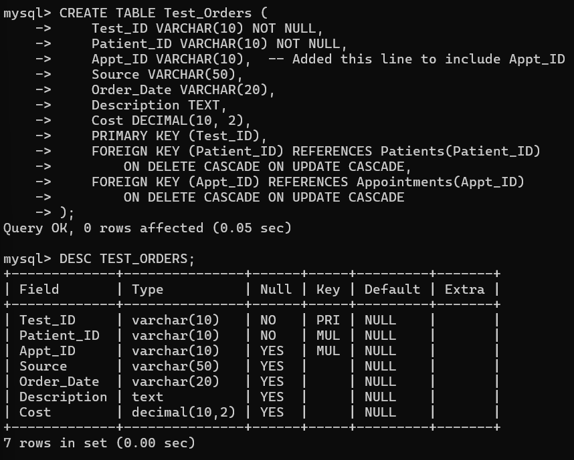
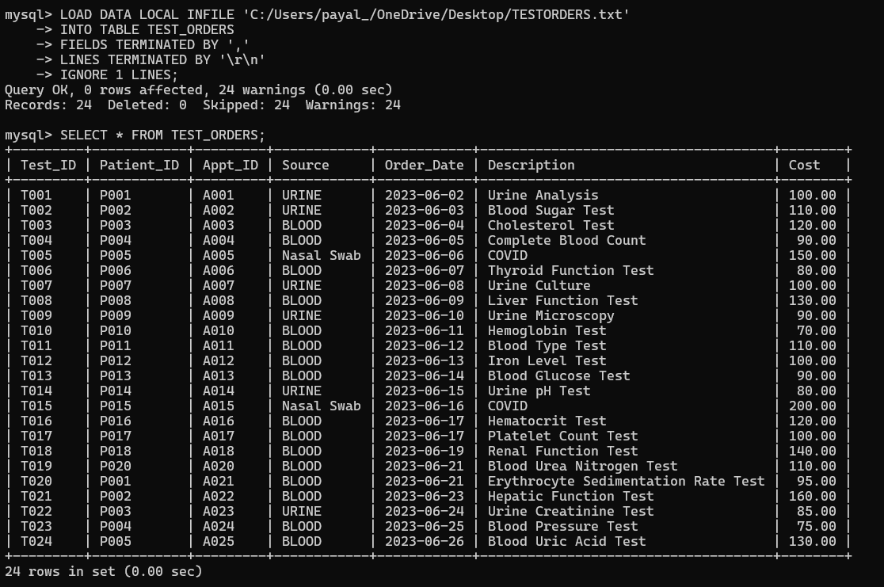
Test order table

Slide 12
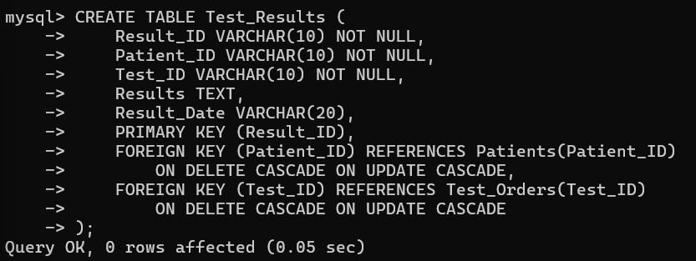
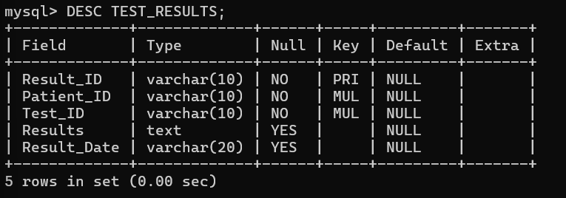
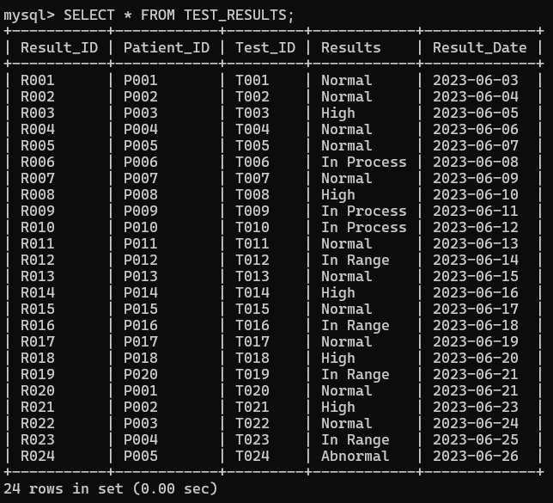
Test Result table

Slide 13
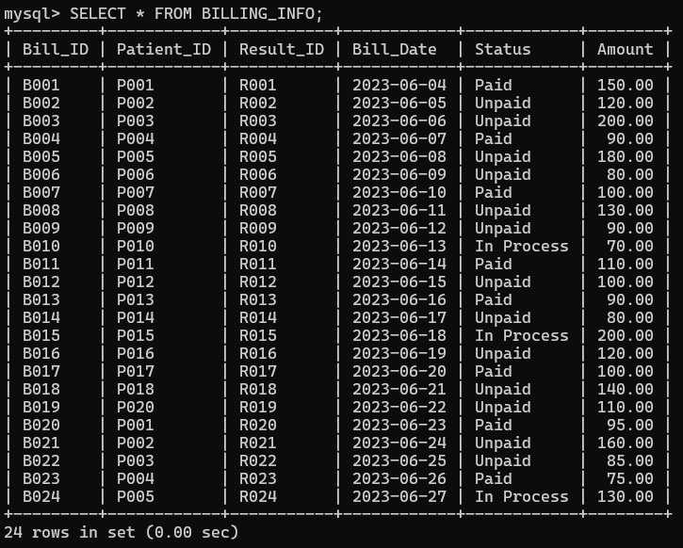
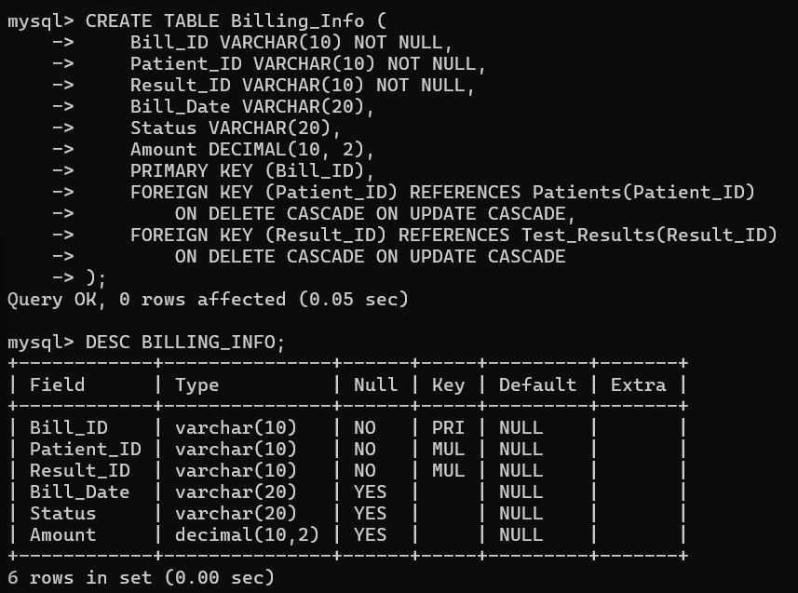
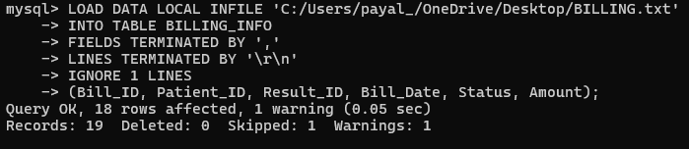
Billing table

Slide 14
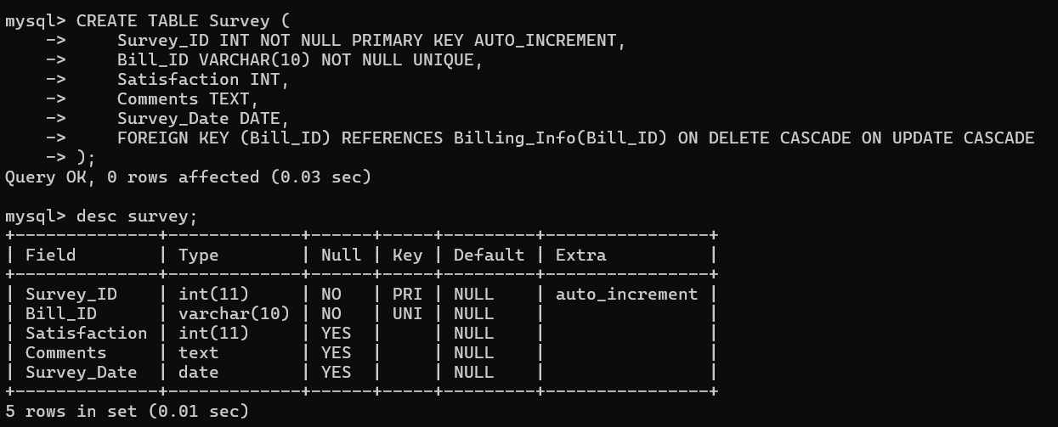
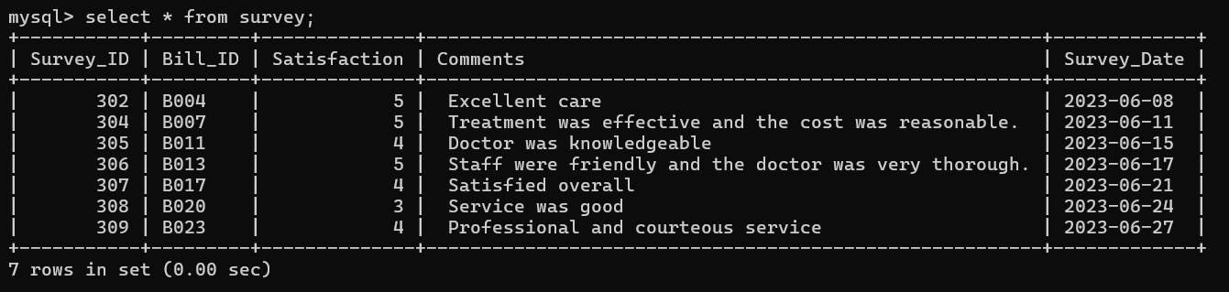
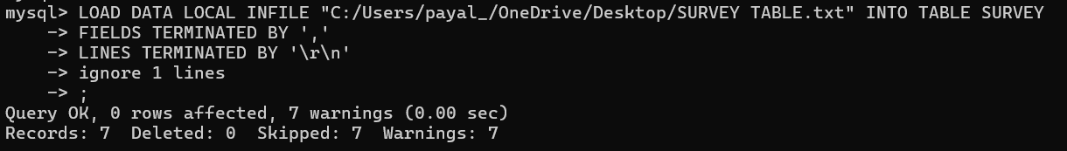
Survey table

Slide 15
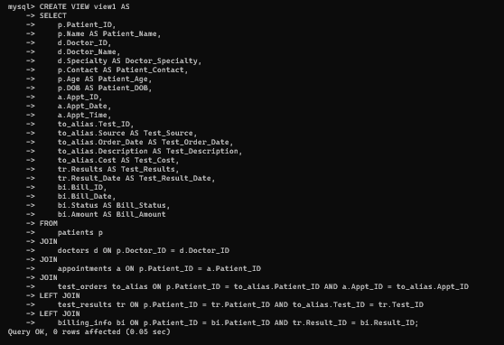
Create a view and show all tables together

Slide 16
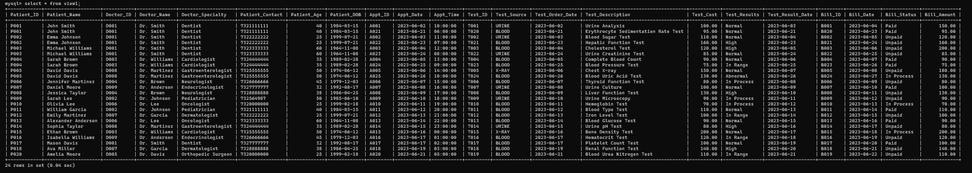
Create a view and show all tables together

Slide 17
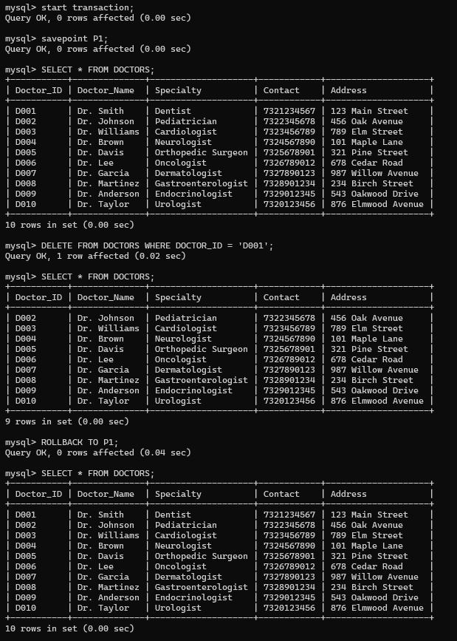
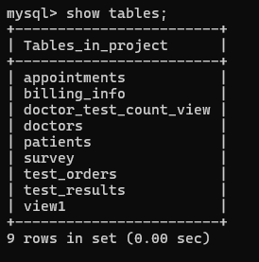
Using Start Transaction Delete data and Rollback

Slide 18

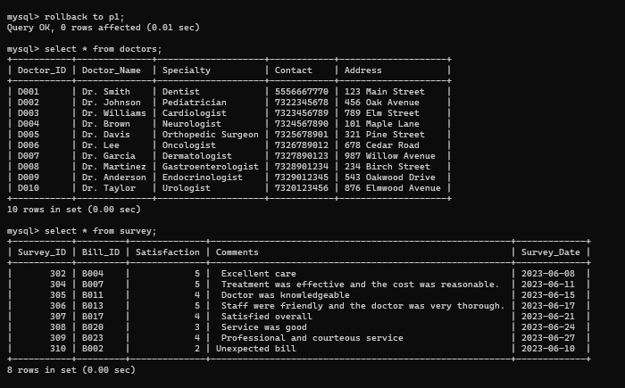
Using Start Transaction Delete data and Rollback

Slide 19
Objectives
1. "Which patients have appointments scheduled but do not have any corresponding test orders and results?"
2. Which doctors have appointments for patients under the age of 50 scheduled after '2023-06-15'?
3. What is the average cost of medical tests per patient within this dataset?
4. What is the total amount billed for all patients treated by a particular specialty?
5. Which tests ordered before '2023-06-10' are either 'Urine Analysis' or 'Blood Sugar Test' and cost more than $100?
6. Which doctors have a total billing amount exceeding $500 for patients over the age of 30?
7. What percentage of appointments result in test orders?
8."What additional laboratory tests might be recommended for Olivia Lee to undergo?"

Slide 20
Objectives
9. Retrieve a list of patients whose billing status is 'In Process' and whose test results are 'Normal'.
10. Which patient of the most advanced age has received a high result on their tests?
11. How does patient satisfaction relate to the type of medical test and the outcome of those tests?
12. Which doctors have a patient satisfaction rating higher than the average rating, and what are their specialties?
13. What is the relationship between patients' satisfaction levels and their billing status ?
14. Which doctors have the most positive satisfaction ratings relative to the number of surveys?
15. Which specialty has the lowest patient satisfaction and what is the average cost associated with these ratings?
16. How does the number of tests per patient vary between those with normal vs. abnormal test results?
17. Retrieve all doctors and any associated patients.
18. Retrieve List of all patients along with their test orders, including patients without any test orders
19. create a view that counts the number of tests ordered by each doctor, grouped by the doctor's ID,
20. Create an index on Patient_Id (Patient table)

Slide 21
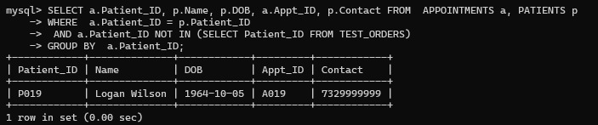
Results: 1. "Which patients have appointments scheduled but do not have any corresponding test orders and results?"

Slide 22
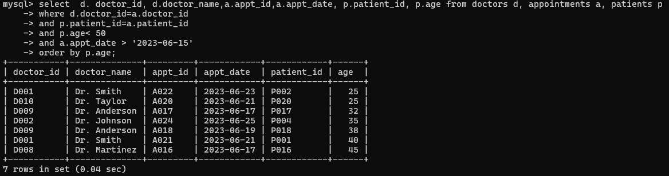
2. Which doctors have appointments for patients under the age of 50 scheduled after '2023-06-15'?

Slide 23
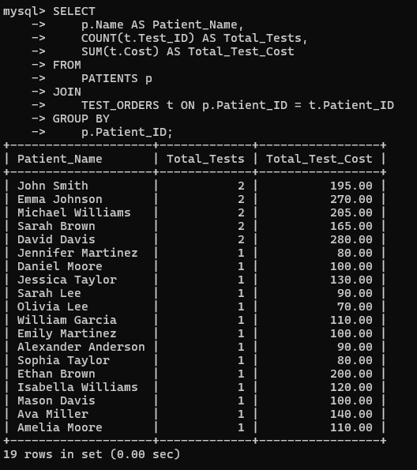
3. What is the average cost of medical tests per patient within this dataset?

Slide 24
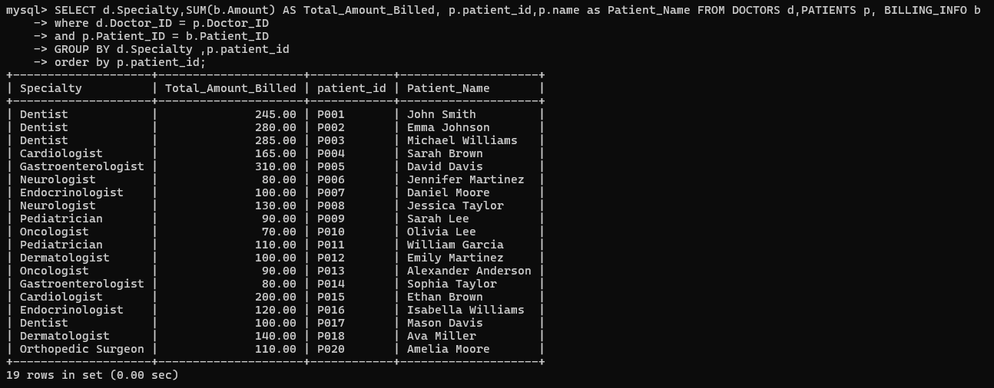
4. What is the total amount billed for all patients treated by a particular specialty?

Slide 25
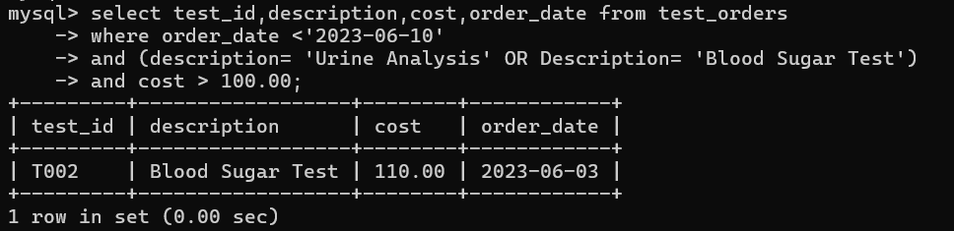
5. Which tests ordered before '2023-06-10' are either 'Urine Analysis' or 'Blood Sugar Test' and cost more than $100?

Slide 26
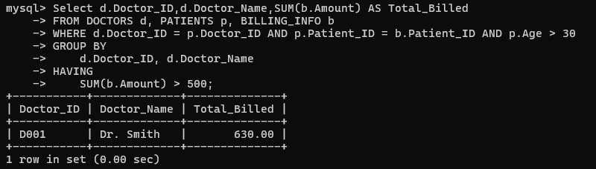
6.Which doctors have a total billing amount exceeding $500 for patients over the age of 30?

Slide 27
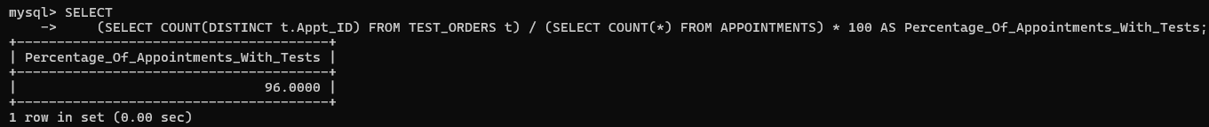
7. What percentage of appointments result in test orders?

Slide 28
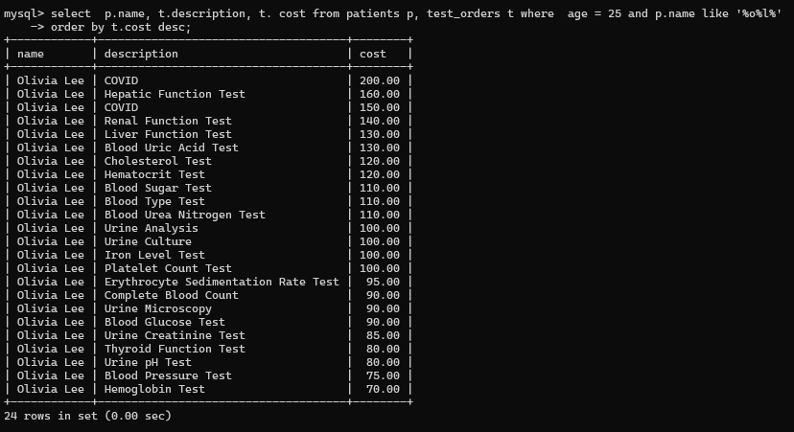
8."What additional laboratory tests might be recommended for Olivia Lee to undergo?"

Slide 29
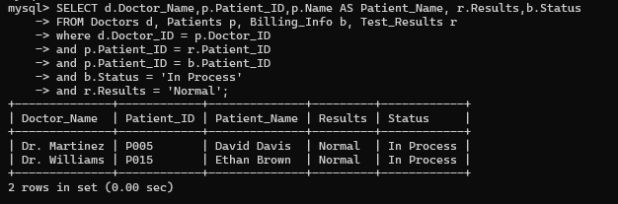
9. Retrieve a list of patients whose billing status is 'In Process' and whose test results are 'Normal'.

Slide 30
10. "Which patient of the most advanced age has received a high result on their tests?"

Slide 31
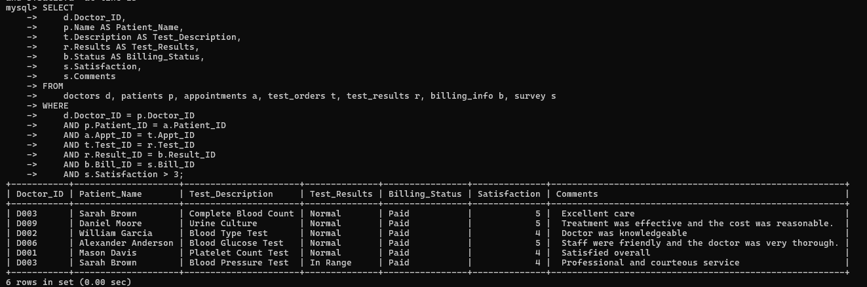
11. How does patient satisfaction relate to the type of medical test and the outcome of those tests?

Slide 32
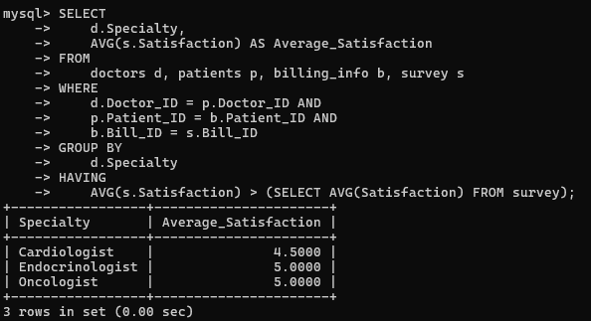
12. Which doctors have a patient satisfaction rating higher than the average rating, and what are their specialties?

Slide 33
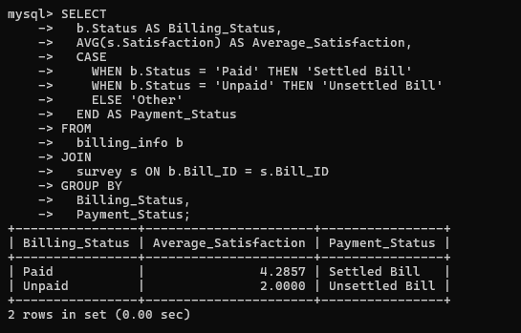
13. What is the relationship between patients' satisfaction levels and their billing status

Slide 34
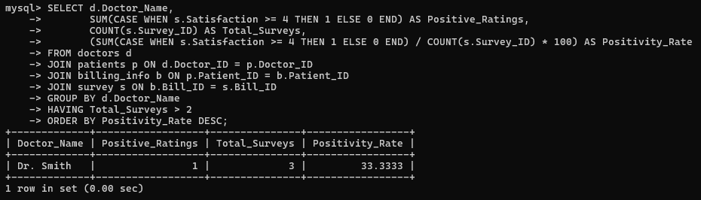
14. Which doctors have the most positive satisfaction ratings relative to the number of surveys?

Slide 35
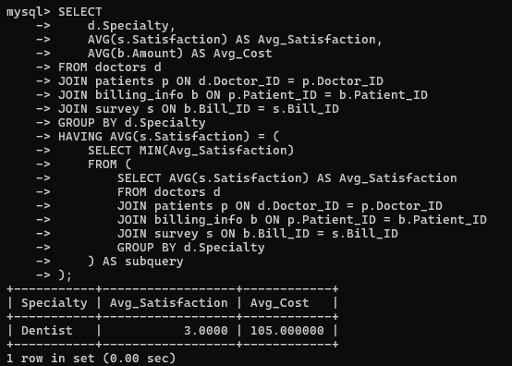
15. Which specialty has the lowest patient satisfaction and what is the average cost associated with these ratings?

Slide 36
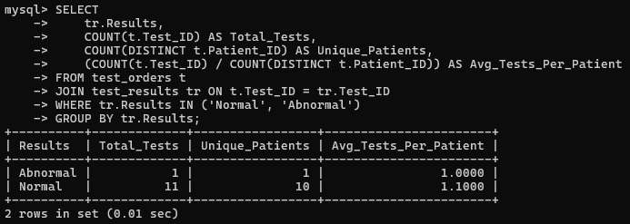
16. How does the number of tests per patient vary between those with normal vs. abnormal test results?

Slide 37
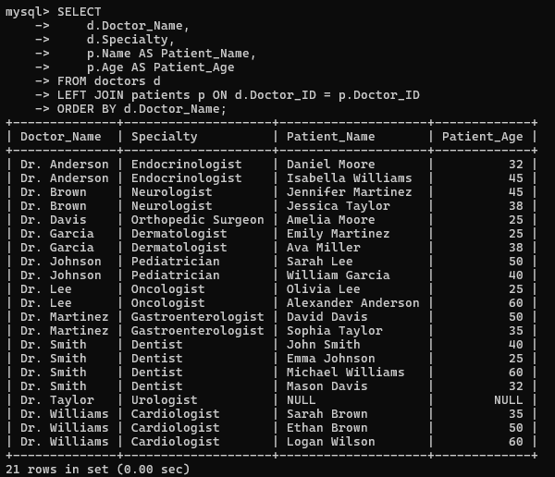
17. Retrieve all doctors and any associated patients.

Slide 38
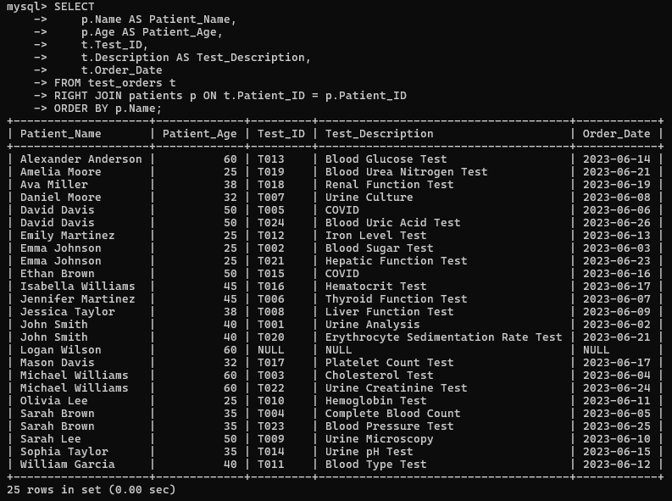
18.Retrieve List of all patients along with their test orders, including patients without any test orders

Slide 39
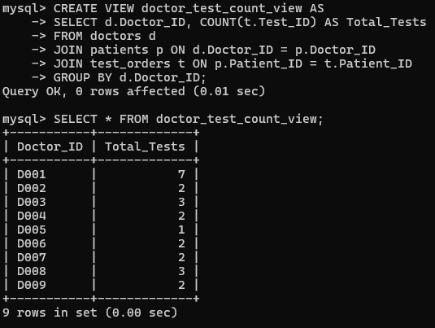
19.create a view that counts the number of tests ordered by each doctor, grouped by the doctor's ID,

Slide 40
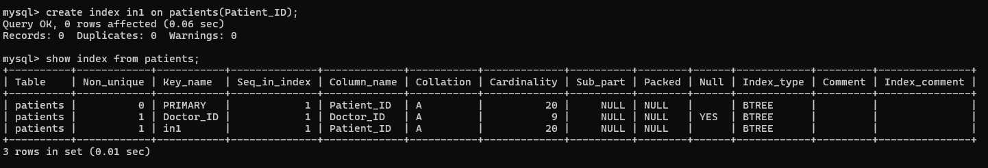
20.Create an index on Patient_Id (Patient table)

Slide 41
Conclusion
A major advancement in the digital transformation of our laboratory operations has been made with the deployment of our laboratory database system.
The technology has created a centralized repository that improves the dependability of data processing and retrieval procedures while streamlining workflows by merging patient data with test orders and results.
Crucially, the approach has demonstrated a noticeable influence on patient care.
Healthcare professionals may manage patient histories more effectively and create treatment plans that are better informed with more readily available and reliable test records. Additionally, the database structure minimizes errors that may result from inconsistent information sources or human data entry by guaranteeing data integrity.

